Slide 1
Heredity Biotechnology and genetic techniques
Edited by Ms Rayner 2022

Slide 2
Syllabus:
Recombinant DNA technology and DNA identification technologies are applied in agriculture and environmental conservation
Describe how recombinant DNA is created and the tools used in this process
Essential
Question:

Slide 3
What you need to complete
BIOLOGY WA UNITS 3&4
Chapter 6 Biotechnology- Its Tools and Techniques pg. 169-198
Set 6.2 pg. 174 Q1-6 DNA TOOLS USED IN BIOTECHNOLOGY
Set 6.3a pg. 180 Q1-7 DNA TECHNIQUES & VOCAB AND PCR
Set 6.3b pg. 183-184 Q1-6 GEL ELECTROPHORESIS
Set 6.3c pg. 185 Q1-5 MICROARRAYS
Set 6.4a pg. 190 Q1-5 DNA SEQUENCING
Set 6.4b pg. 191 Q1-5 GENOME MAPPING USING DNA SEQUENCING
Set 6.5 pg. 194 Q1-5 DNA PROFILING
Set 6.6 pg. 198 Q1-4RECOMBINANT DNA TECHNOLOGY & TRANSGENIC ORGANISMS
BIOZONE Activity Number:
GMO & RECOMBINANT DNA 141, 142, 143, 144, 159, 160,
GENE CLONING 156, 157, 158,
GEL ELECTROPHORESIS 145, 146,
PCR 147, 148,
DNA PROFILING 149, 150,
APPLICATIONS OF BIOTECH 151, 152,
DNA SEQUENCING 153, 154,
ETHICS OF GMO 161,
TERMINOLOGY 162

Slide 4
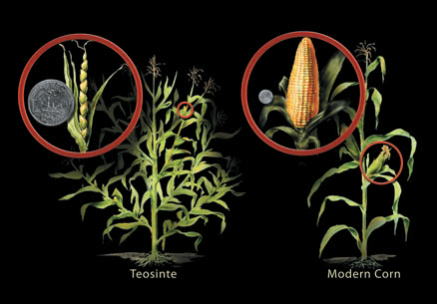
Introduction to biotechnology
Topic Question 1: Define the term Biotechnology
The term biotechnology refers to the artificial tools and techniques used on organisms or the products of organisms to make a product or solve a problem for human benefit.
Biotechnology combines biology and technology to improve our lives and the health of our planet.
Example:
Science Photo Library/NICOLLE RAGER FULLER/NATIONAL SCIENCE FOUNDATION
The corn you eat is the domesticated version of a wild grass called teosinte. Teosinte was selectively bred for thousands of years before the modern corn plant developed.

Slide 5
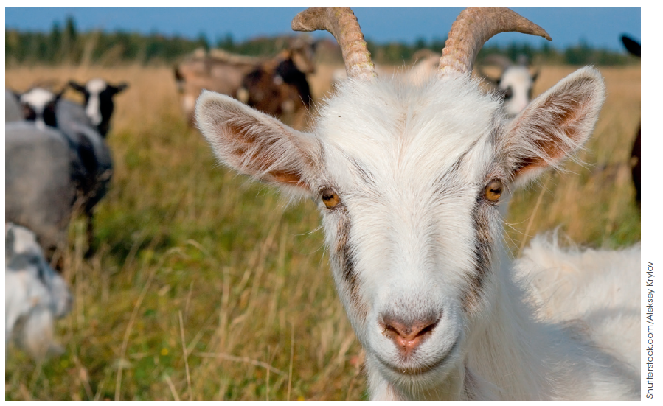
Biotechnology
Topic Question 1: Define the term Biotechnology
Biotechnology is the use of living things to make new products or systems.
Figure 5.1
Early examples include domestication and the use of microorganisms to produce bread, beer, wine and cheese.

Slide 6
DNA-based biotechnology
Topic Question 2: Describe how restriction enzymes, ligase enzymes, polymerase enzymes and primers are used in DNA based biotechnology
Modern biotechnology involves processing and manipulating DNA.
Biotechnology has its own set of specialised tools and techniques, which are mostly derived from organisms.
Biotechnology
Tools
Techniques

Slide 7
DNA-based biotechnology
Topic Question 2: Describe how restriction enzymes, ligase enzymes, polymerase enzymes and primers are used in DNA based biotechnology
Tools are required for synthesising, cutting and pasting, viewing and analysing DNA. Many of these tools are enzymes.
Tools used in DNA-based biotechnology
Restriction enzymes
Ligase
Polymerases
Primers
Use the following slides to take notes on restriction enzymes and ligase
Read Biology WA ATAR Units 3 & 4 page 170 & take notes on ligase & primers

Slide 8
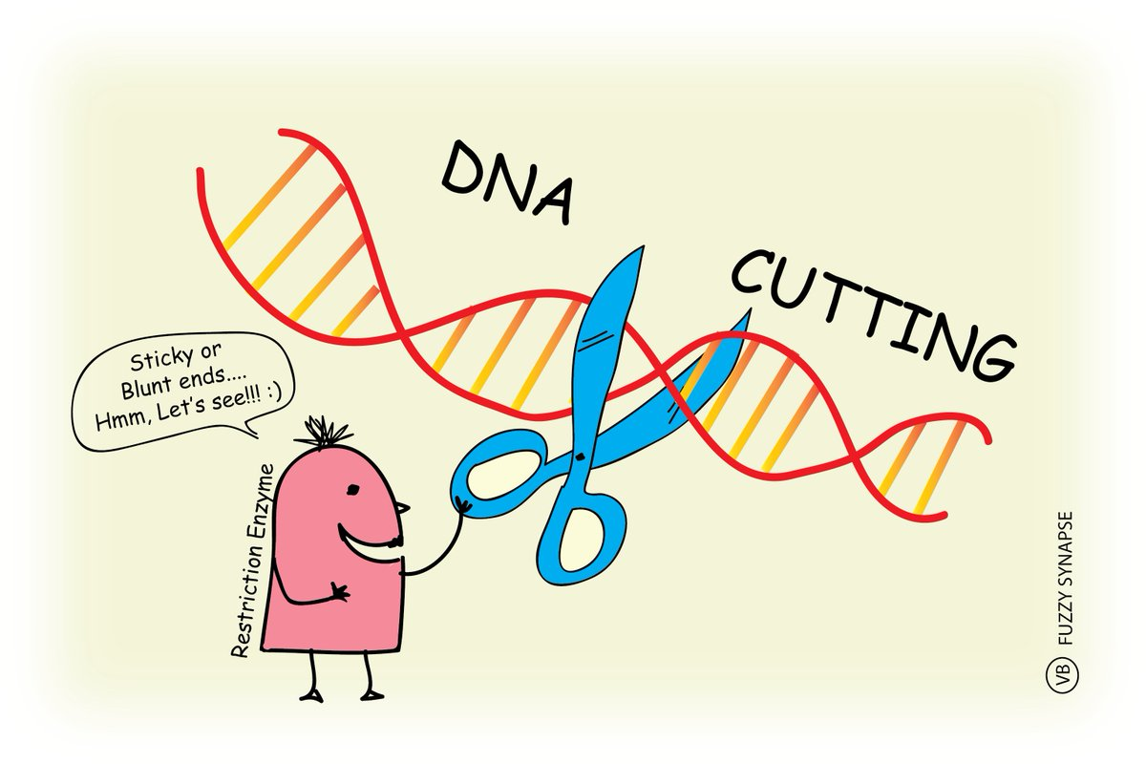
DNA-based biotechnology
Topic Question 2: Describe how restriction enzymes, ligase enzymes, polymerase enzymes and primers are used in DNA based biotechnology
Enzymes from bacteria can cut DNA at specific sites.
Naturally occurring restriction enzymes protect bacteria by cutting foreign DNA and then removing invading organisms.
These enzymes are called restriction endonucleases
(endo = within, nuclease = cuts DNA).

Slide 9
Genetic engineering techniques
Topic Question 2: Describe how restriction enzymes, ligase enzymes, polymerase enzymes and primers are used in DNA based biotechnology
They each have a different sequence they recognise and cut.
These are called restriction sites or recognition sites.
Recognition sites are usually 4–8 bases long.
EcoRI restriction site

Slide 10
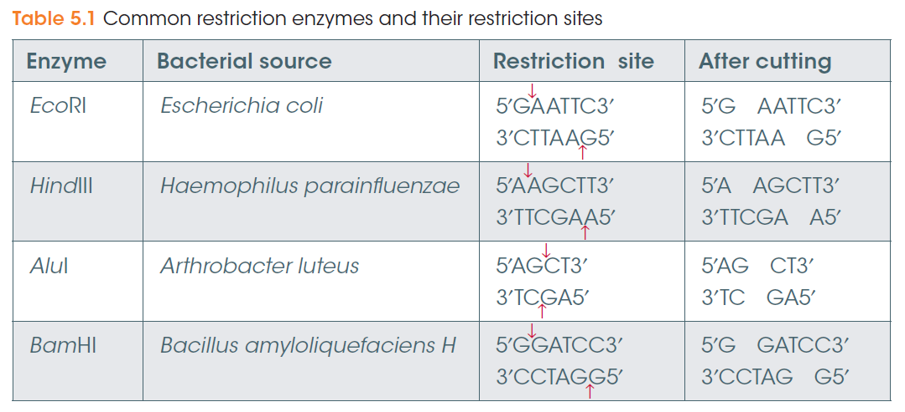
Genetic engineering techniques
Topic Question 2: Describe how restriction enzymes, ligase enzymes, polymerase enzymes and primers are used in DNA based biotechnology

Slide 11
DNA-based biotechnology
Topic Question 2: Describe how restriction enzymes, ligase enzymes, polymerase enzymes and primers are used in DNA based biotechnology
Each restriction enzyme recognizes just one or a few restriction sites. When it finds its target sequence, a restriction enzyme will make a double-stranded cut in the DNA molecule.
Typically, the cut is at or near the restriction site and occurs in a tidy, predictable pattern.

Slide 12
Genetic engineering techniques
Topic Question 2: Describe how restriction enzymes, ligase enzymes, polymerase enzymes and primers are used in DNA based biotechnology
Restriction enzymes can leave DNA with sticky ends (top) or blunt ends (below).
Sticky ends are easier to join in the correct orientation.

Slide 13
Genetic engineering techniques
Topic Question 2: Describe how restriction enzymes, ligase enzymes, polymerase enzymes and primers are used in DNA based biotechnology
Ligases are enzymes that join (ligate) the sugar-phosphate backbones of DNA fragments.
A restriction fragment is often inserted into a vector (carrier) such as a bacterial plasmid so it can be easily copied in bacterial cells.
To increase the chances of the fragment inserting into the plasmid in the correct orientation, the plasmid can be cut with the same restriction enzymes to produce the same sticky ends.

Slide 14
Genetic engineering techniques
Topic Question 2: Describe how restriction enzymes, ligase enzymes, polymerase enzymes and primers are used in DNA based biotechnology
Watch the simulation of a restriction and ligase enzyme
http://www.dnai.org/b/index.html

Slide 15
Genetic engineering
Topic Question 3: Describe the role of restriction enzymes and ligase in recombinant DNA technology
Restriction enzymes and ligase are used to produce recombinant DNA
Recombinant DNA technology is the technology used to recombine DNA from different sources to modify the DNA sequence of an organism
A Restriction enzyme is used to cut/isolate a target gene from a donor organism and the same restriction enzyme is used to cut the plasmid of a bacteria to produce sticky ends
Ligase is used to bind the target gene to the plasmid DNA
Watch the simulation of how to make recombinant DNA
http://www.dnai.org/b/index.html

Slide 16
Genetic engineering techniques
Now lets make recombinant DNA
https://www.youtube.com/watch?v=0QwnR_JVCZc

Slide 17
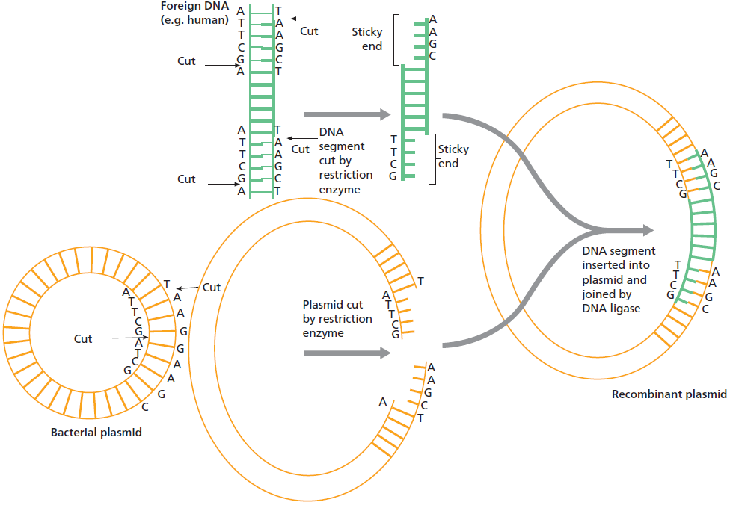
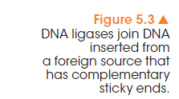
Topic Question 4: Label the diagram of recombinant DNA technology

Slide 18
Copying DNA
Genetic engineering techniques
Recombinant plasmids can be put into bacterial cells (e.g. E. coli) and the bacteria grown in culture.
This produces many copies, or clones, of the plasmid.
The bacterial cells can be burst open, or lysed, and the plasmid DNA extracted for the next part of the process.
This is discussed in more detail later.
Another way to copy DNA or amplify DNA is to use PCR

Slide 19
Copying DNA or amplifying DNA
Genetic engineering techniques
Another method of making many copies of a DNA fragment is by the Taq polymerase chain reaction (PCR).
This is essentially DNA replication in vitro, or in a test tube. It uses free nucleotides, a template strand of DNA and DNA polymerase.
Other components include a buffer that produces the conditions for the polymerase to work effectively, and primers.
Primers are short (~20bp) single stranded DNA fragments that bind to the 5’ end of the template. They are necessary because DNA polymerase can only extend an existing strand of DNA.

Slide 20
Topic Question 5: State the main function of PCR
The polymerase chain reaction (PCR) relies on cycles of temperature. The cycle is repeated numerous times
Uses the enzyme DNA Polymerase to reproduce large amounts of particular genes in vitro
Typically the goal of PCR is to make enough of the target DNA region so it can be analysed or used in some other way
For example:
DNA amplified by PCR can be sequenced (DNA sequencing)
Visualised by gel electrophoresis for DNA profiling
Or inserted into a plasmid (Recombinant DNA)

Slide 21
Topic Question 6: List the phases of PCR and state the temperatures experienced during each phase
Denaturation 96°C
Annealing
55 - 65°C
Extension
72°C
1
2
3
The temperature depends on the nucleotide composition and length of the primers.

Slide 22
Topic Question 7: Describe the role of each PCR component
PCR Component | Suggested role in PCR
DNA | Act as a template so new DNA strands can be synthesised
Primers | Primer. Short sequences (approx. 20 nucleotides) complementary to the nucleotide sequences at either end of the DNA section to be copied. These are the starting points necessary for the Taq polymerase to add new nucleotide bases
Nucleotides | Four DNA nucleotides used to build the new DNA molecule
Taq polymerase | Synthesises the complementary DNA strand in a 5’ to 3’ direction
Buffer Solution | contains MgCl₂ (salts) and other chemicals that help the Taq polymerase to function

Slide 24
Topic Question 5: Describe the three phases of PCR and explain the importance of the temperatures to the processes
Denaturation 96°C
Annealing
55 - 65°C
Extension
72°C

Slide 25
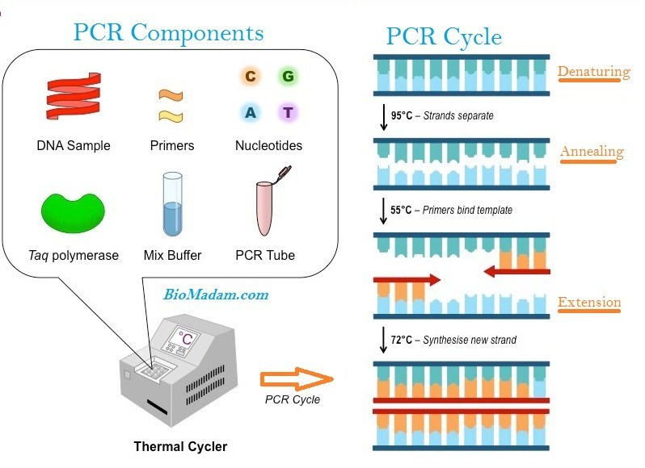
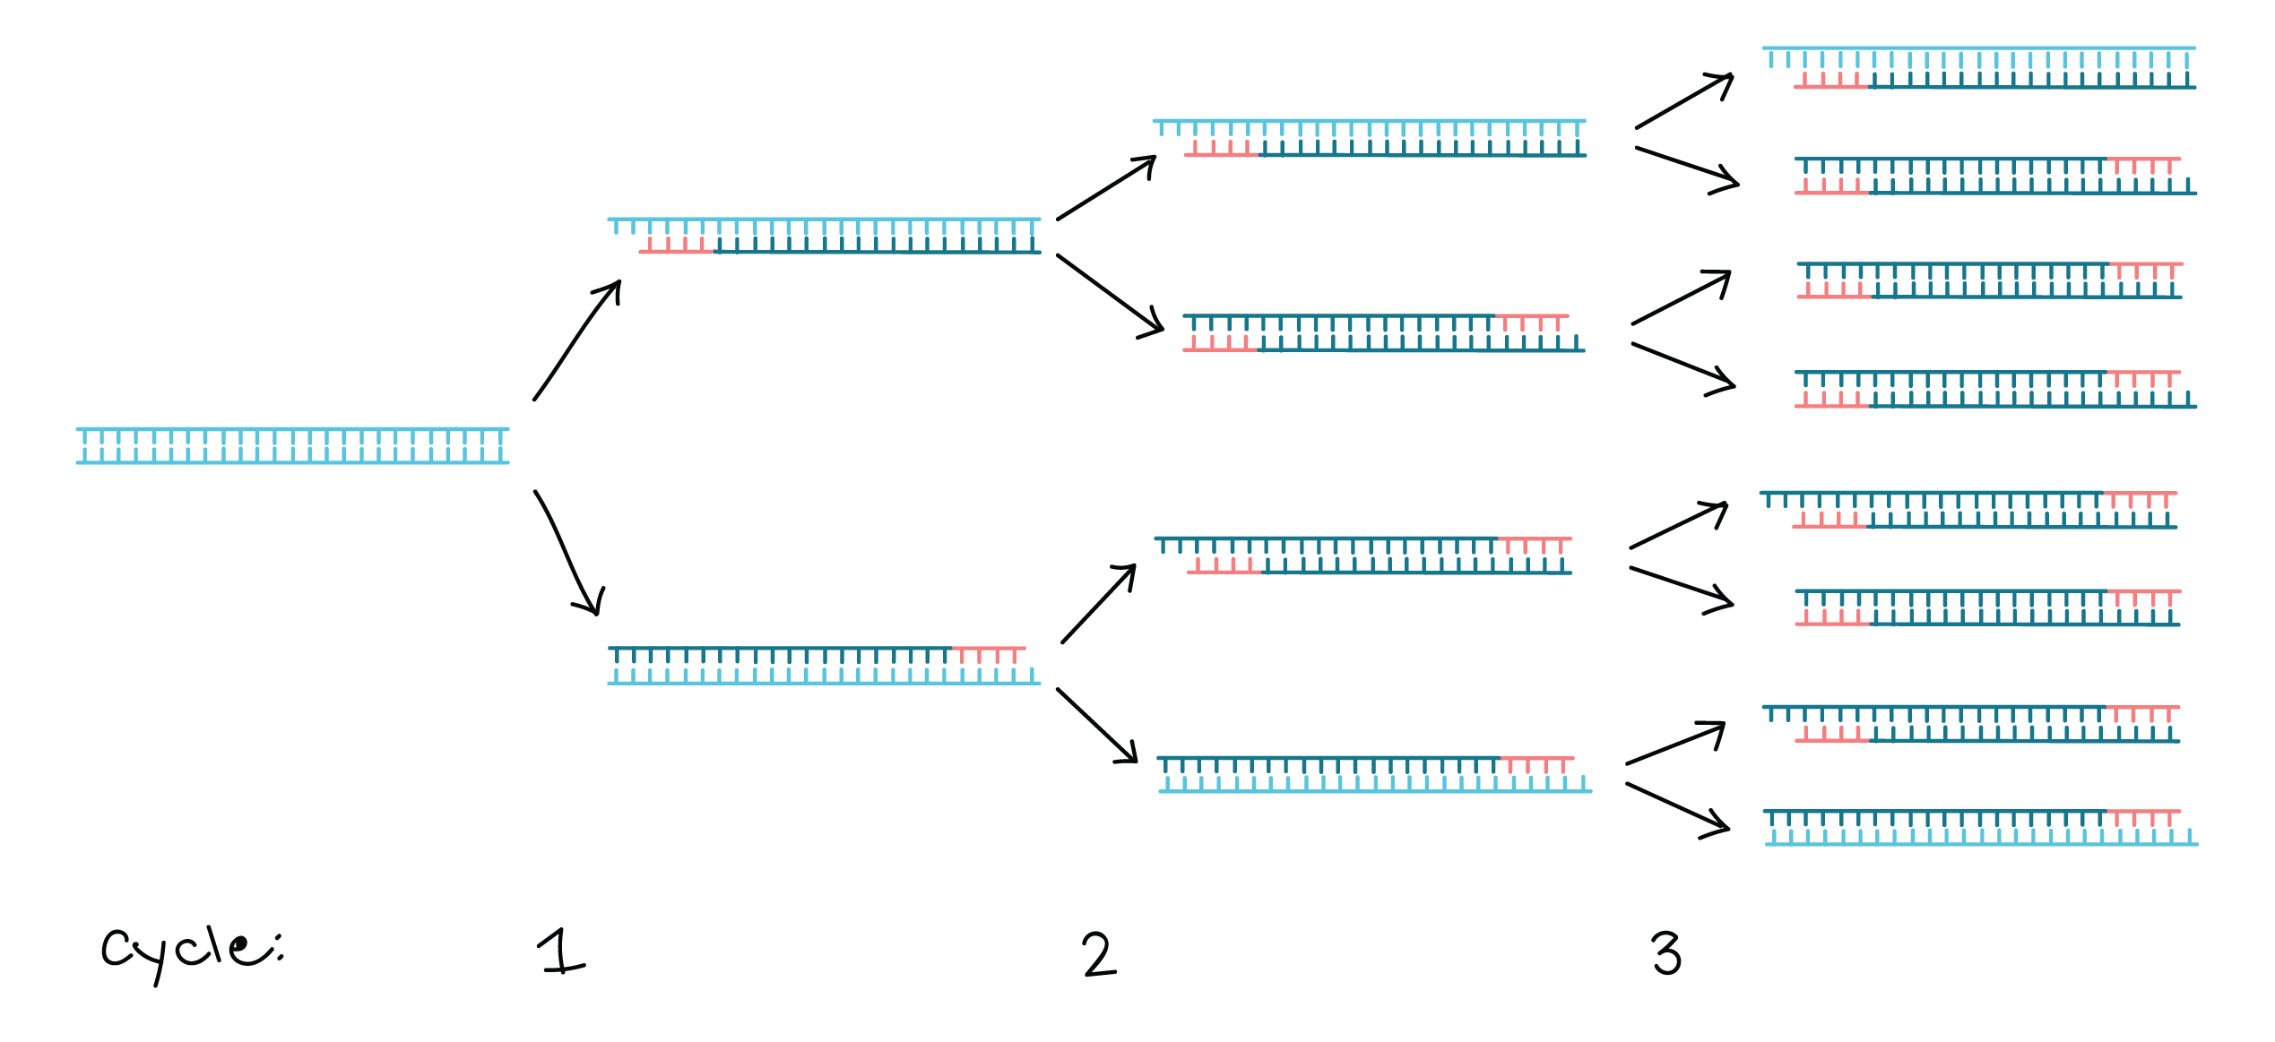

Slide 26
Topic Question 8: Describe the three phases of PCR
Denaturation (write and draw in the first box of your worksheet)
The double stranded DNA is heated strongly to 95C
There is not DNA helicase so the DNA is heated
This denatures the strands, meaning the DNA strands will separate as the hydrogen bonds are broken
This provides single-stranded template for the next step

Slide 27
Annealing (Draw and write in the second box on your worksheet)
The temp is cooled to 55-65C so the primers can anneal (bind) to their complementary sequences on the opposite ends of each single-stranded template DNA
The reduced temperature is necessary to allow base pairing & the formation of hydrogen bonds therefore allowing the primer to anneal or bind to the complementary base sequence either end of the DNA template to be copied
The temperature depends on the nucleotide composition and length of the primers.

Slide 28
Elongation (Draw and write in the third box on your worksheet)
Temperature of the reaction is raised to 72C. This is the optimal temperature of the Taq polymerase
Starting from the primers, new DNA strands are synthesised using Taq polymerase & the available nucleotides which are laid down in a 5’ to 3’ direction
At the end of this phase there are 2 copies of the double-stranded DNA
The DNA polymerase used is from a thermophile, Thermus aquaticus, a bacteria that lives in hot springs and can tolerate the 95°C melting temperature of PCR.

Slide 29
Topic Question 9: After each PCR cycle, what happens to the number of DNA fragments?
After each cycle the number of DNA fragments is doubled
This cycle is repeated many times until sufficient quantities of DNA has been obtained.
Each cycle doubles the number of DNA strands
After around 20 cycles more than 1 million copies of target DNA will be produced
After 30 – 35 cycles = billion fold of copying segment

Slide 30
